Slide 1
Parallel Architectures
CSC 211.01 — Friday, December 4, 2015

Slide 2

A few months ago,
in a valley far, far away…

Slide 3


This is Bob.
Bob has an idea
for a startup.

Slide 4


Slide 5





It’s going to totally disrupt image search.
found 8,000,000
similar images

Slide 6


The Prototype
Take a picture
Add it to
the database
Send it to Ogle
found 8,000,000
similar images
Send results
Find similar pictures

Slide 7

Ogle is totally disrupting image search.

Slide 8

Ogle is too slow!
loading…

Slide 9
How can Bob make Ogle faster?
“ ”
Optimizations
Use a faster language
Use a faster algorithm
Parallelize

Slide 10

Why we have to write parallel programs

How to write parallel programs

Why parallel programming is hard

Slide 11

Running a program is like running errands
The Dark Art of Software Performance

Why we have to write parallel programs
go to bank
cash check
go to store
buy milk
go home
put away milk

How to write parallel programs

Why parallel programming is hard
⬅
How to make parallel programs fast

Slide 12
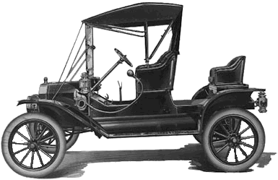
Bob needs a car to run errands
go to bank
cash check
go to store
buy milk
go home
put away milk

Slide 13
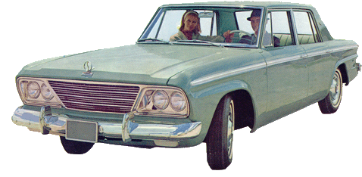
Bob needs a car to run errands
Bob can run errands faster with a faster car
go to bank
cash check
go to store
buy milk
go home
put away milk

Slide 14

Bob needs a car to run errands
Bob can run errands faster with a faster car
go to bank
cash check
go to store
buy milk
go home
put away milk

Slide 15
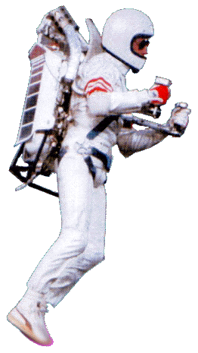
Bob needs a car to run errands
Bob can run errands faster with a faster car
We were promised jetpacks.
go to bank
cash check
go to store
buy milk
go home
put away milk

Slide 16
Bob needs a car to run errands
Bob can run errands faster with a faster car
We were promised jetpacks.
No such luck. Instead…
Bob gets a deal on a four-pack of cars.
Can Bob run his errands
faster with four cars?
go to bank
cash check
go to store
buy milk
go home
put away milk

Slide 17

Bob and Alice can split up errands
Now they can use two cars instead of one
go to bank
cash check
go to store
buy milk
go home
put away milk
go to bank
cash check
go to store
buy milk
go home
put away milk

Slide 18

Performance used to be easy
Transistors (millions)
Clock Speed (MHz)
Too Hot!
Transistor counts
still increased
Smaller = Faster
Just buy new hardware
and Ogle will run faster
Log scale
What happened?
Year
Year

Slide 19
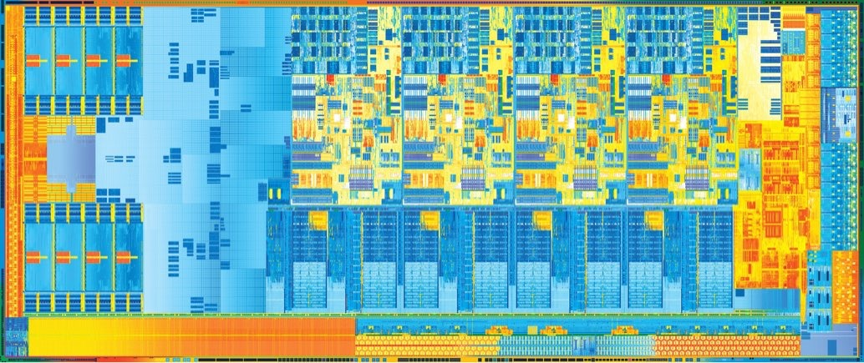
Where do all those transistors go?
Instead of faster processors, we just get more.
Four cores
Really just four separate processors
Individually, they aren’t any faster than a Pentium 4 from 2005

Slide 20
Where do all those transistors go?
Instead of faster processors, we just get more.
total = 0
for i in range(0,10):
total += i
print total
product = 0
for i in range(0,10):
product *= i
print product
go to bank
cash check
go to store
buy milk
go home
put away milk
go to bank
cash check
go to store
buy milk
go home
put away milk

Slide 21
Where do all those transistors go?
total = 0
for i in range(0,10):
total += i
print total
product = 0
for i in range(0,10):
product *= i
print product
One core runs a sequence of steps
starting at the beginning of your program.
to use more cores, you have to provide more sequences of steps

Slide 22
Where do all those transistors go?
total = 0
for i in range(0,10):
total += i
print total
product = 0
for i in range(0,10):
product *= i
print product
Each sequence is called a thread.

Slide 23
Where do all those transistors go?
Each sequence is called a thread.
One thread can only run on one core at a time.
We have to write parallel programs to
fully utilize modern processors.

Slide 24

Why we have to write parallel programs

How to write parallel programs

Why parallel programming is hard

Slide 25

Why we have to write parallel programs

How to write parallel programs

Why parallel programming is hard

Slide 26


we have to write a parallel program.
time
A
B
A()
B()

Slide 27
we have to write a parallel program.
time
A
B
What does the parallel
version look like?
A
t = thread(B)
A()
t.join()
B

Slide 28
we have to write a parallel program.
time
A
B
A
B

Slide 29
time





c = compress(img)
save(c)
f = features(img)
m = findMatches(f)
return m

Slide 30
time


This version will run much faster
but will it work?




Slide 31
time

Ogle has to compress the
image before it can save it





Slide 32
time




Ogle has to find matches
before they can be sent


Slide 33
time


Ogle has to get features
before it can search with them




Slide 34
time





Finally, wait for both threads to finish before exiting.

Slide 35
time





This should work, right?
loading…

Slide 36

time





This should work, right?
Ogle is crashing!
loading…

Slide 37
New Kinds of Errors
time





These threads read and write the
image database at the same time.

Slide 38

Why we have to write parallel programs

How to write parallel programs

Why parallel programming is hard

Slide 39

Why we have to write parallel programs

How to write parallel programs

Why parallel programming is hard

Slide 40
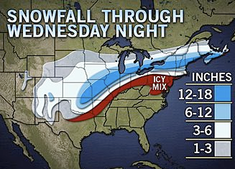
Race Conditions
I’ll make sure we have bread and milk
I’ll make sure we have bread and milk

Slide 41
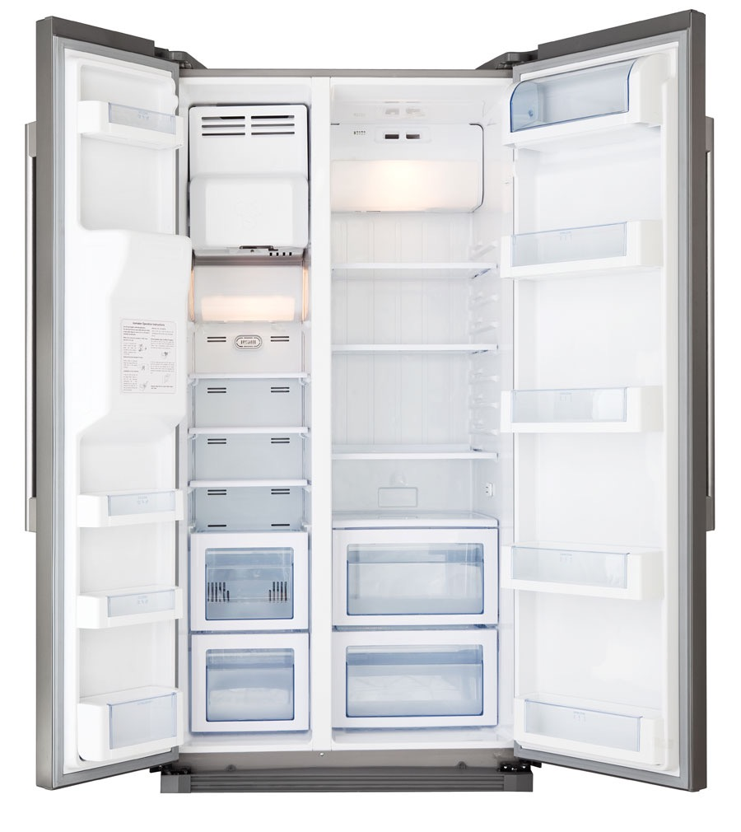
Oh no! Better go to the store.
Oh no! Better go to the store.

Slide 42
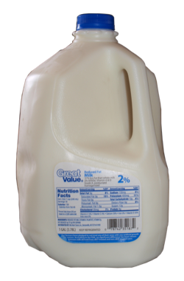
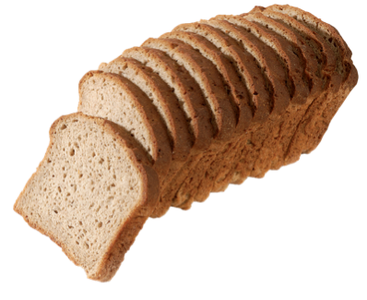

Slide 43
I hate race conditions!

Slide 44
Try again with a lock
I’ll make sure we have bread and milk
I’ll make sure we have bread and milk

Slide 45
Oh no! Better go to the store.

Slide 46
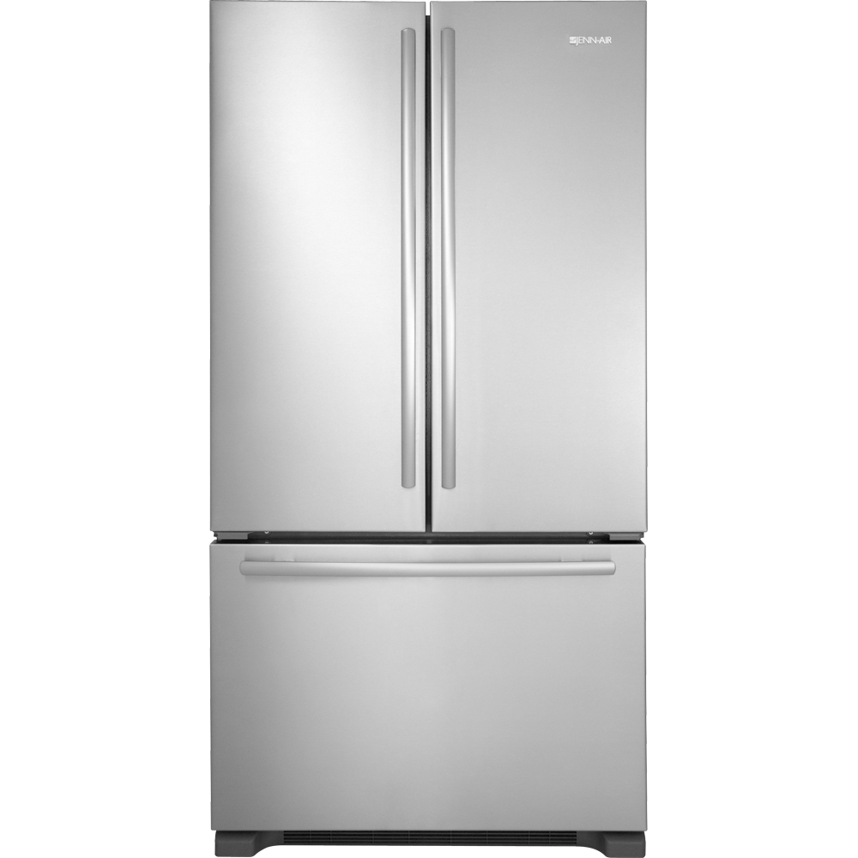


Slide 49
Oh good, we have bread and milk.

Slide 50
Not so different for programs

Slide 51
Race Conditions
x=0
y=0
if x==0
if y==0
y=1
x=1
What are the values of x and y?

Slide 52
Race Conditions
x=0
y=0
if x==0
y=1
if y==0
x=1
x=0
y=1

Slide 53
Race Conditions
x=0
y=0
if y==0
x=1
if x==0
y=1
x=1
y=0

Slide 54
Race Conditions
x=0
y=0
if x==0
if y==0
y=1
x=1
Both conditions are true
x=1
y=1

Slide 55
Race Conditions
x=0
y=0
if x==0
if y==0
y=1
x=1
Programmer probably expected
these statements to run atomically.
We can fix this program with locks.

Slide 56
Locks


if x==0
y=1

if y==0
x=1


Slide 57
Locks


if y==0
x=1
if x==0

y=1


Slide 58
Locks
Atomicity comes at a performance cost
Two threads
but only one is active at a time


if y==0
Amdahl’s Law
x=1
1 - B
T(n) =
T(1)
· (B + )

n
if x==0
Adding threads only speeds up the
parallel part of the program.
y=1


Slide 59
Amdahl’s Law

Slide 60
Contention
I wonder if we have any yogurt
I’ll make sure we have bread and milk

Slide 61
Oh no! Better go to the store.

Slide 64
Darn, no yogurt.
Better go to the store.

Slide 65
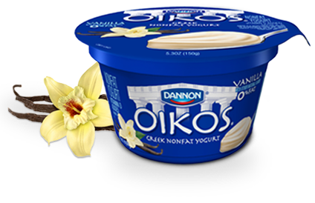

Slide 67
Fine-grained locking
I wonder if we have any yogurt
I’ll make sure we have bread and milk

Slide 68
Darn, no yogurt.
Better go to the store.
Oh no! Better go to the store.

Slide 70
Deadlock
Buy milk and bread.
Buy bread and milk.

Slide 72
Thread Demo Time

